Slide 1





ACTIVE LEARNING
NEW FACULTY ACADEMY,
SPRING 2026

Slide 2




OBJECTIVES
1
Distinguish between types of learner engagement
2
Discuss how to include active learning in your class
3
Actively learn about active learning!!

Slide 3
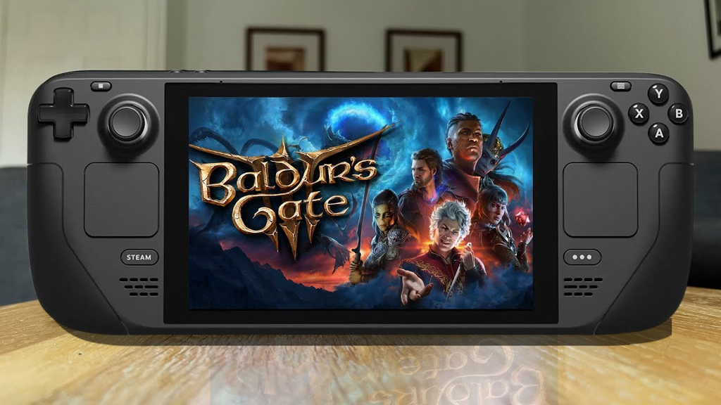



ABOUT
ME

Slide 4
WHAT IS SOMETHING YOU COULD TALK ABOUT FOR HOURS?

Slide 5
SEE WHAT I DID THERE?
  PERSONAL CONNECTION
  LOW STAKES
  LISTENER EXPERTISE

Slide 6


WHAT IS ACTIVE LEARNER ENGAGEMENT?
Learner-
Content
Learner-
Educator
Learner-
Learner
Chickering, A. W., & Gamson, Z. F. (1987). Seven Principles for Good Practice in Undergraduate Education.

Slide 7


TIP: PLAN ACTIVE BREAKS
DURING CLASS
Learner-Content
Learner-Learner
  Case Studies
  Discussion Questions
  One-Minute Papers
  Polls
  Think-Pair-Share
  Projects
  Peer Review
  Debates

Slide 8







“CHUNK AND CHEW”
(Costa, 1981 and Long, Swain & Cummins, 1996) reinforces the importance of allowing at least two minutes of learner processing time with every ten minutes of explanation.
10
2
Make sure to actually give them 2 whole minutes (or more)
Example:
10
2
10
2
10
2
Lecture
+ Question
Example
+ Poll
Explanation +
Minute Paper
Intro
Group
Reflection
Minutes

Slide 9









GROUP ACTIVITIES
Case Studies
Paper Airplane
Questions
Trivia
Group Share
Sticky-Note
Gallery
Debates
Role-playing
Group Discussion
Group Project
Example:
Intro+ Class Question
Group Share
Lecture/
Presentation
Group
Reflection
Activity

Slide 10


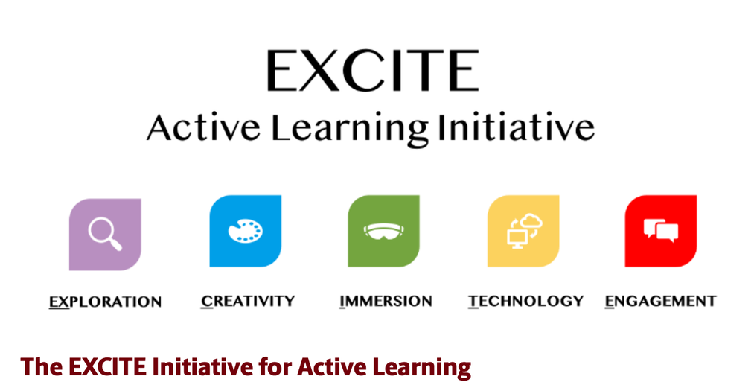
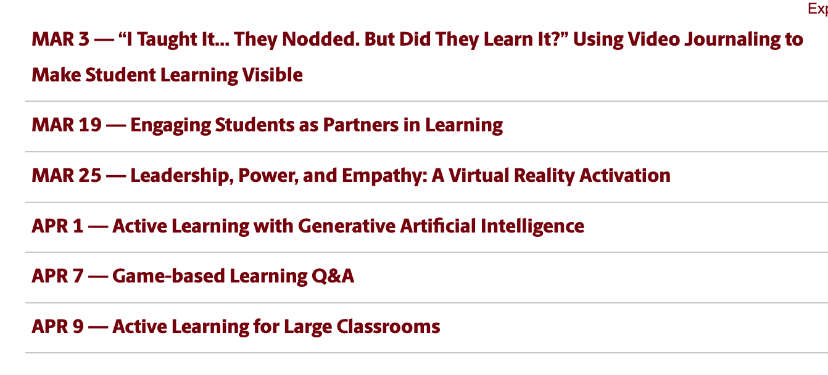
Active Learning Certificate of Completion
Upcoming Workshops

Slide 11
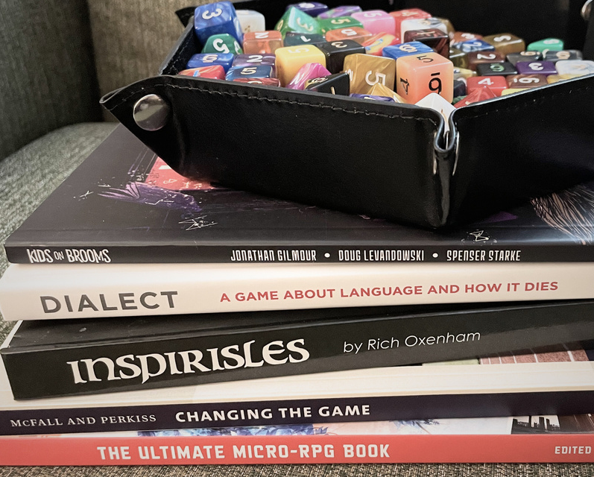
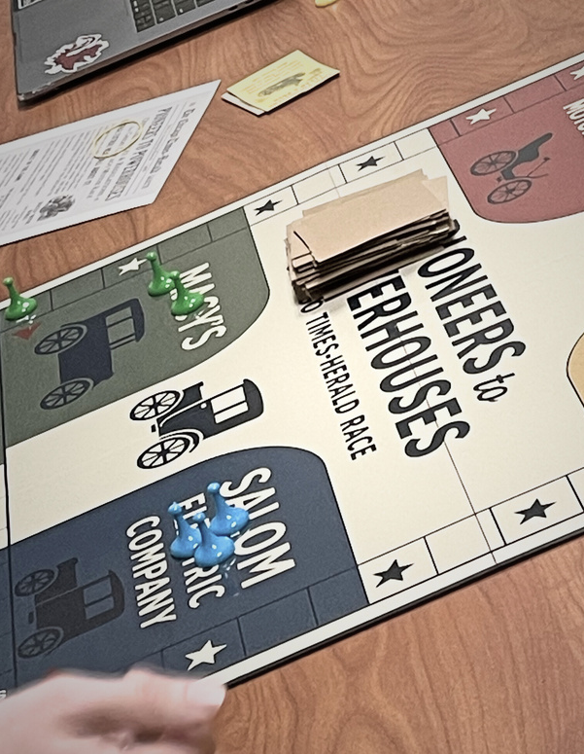
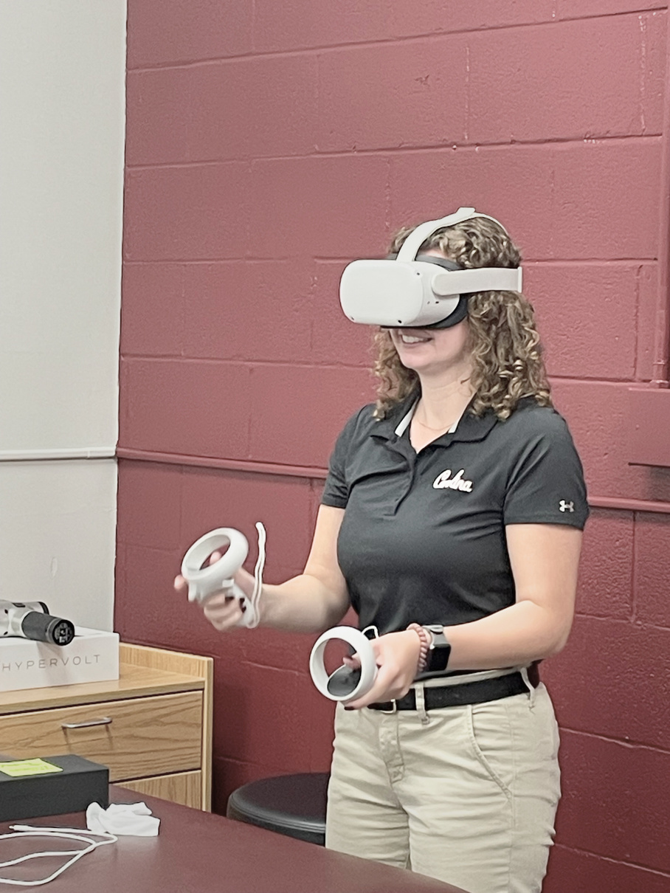



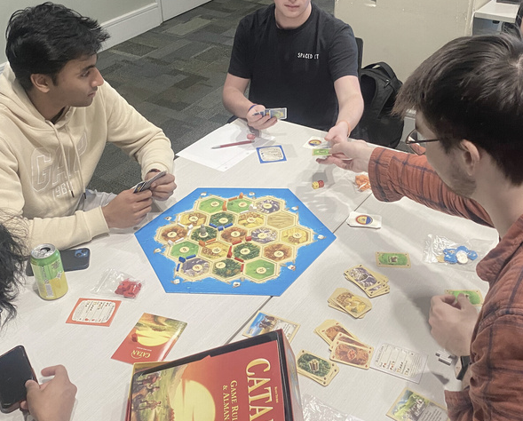

GAME-BASED LEARNING @ USC
  Student engagement
  Critical thinking
  Social interactions
  Knowledge retention
Email kharell@sc.edu for recommendations, tools, and more!

Slide 12


CAREolina
March 23-27, 2026
A week-long celebration
of care and empathy
providing valuable resources for
USC educators
For more info, contact Kristin Harrell (kharrell@sc.edu)

